Slide 1
Module 6
Consumer Buying Behaviour
By: Dr Shahinaz Abdellatif

Slide 2
Objectives of the Session
To adopt the viewpoint of the individual consumer
To identify the psychological process underlying buying behaviour

Slide 3
Consumer Decision Making
Consumer decision making is essentially a problem-solving process.
Most customers, whether individual consumers or organisational buyers, go through similar mental processes in deciding which products and brands to buy.
These differences reflect variations in consumers’ personal characteristics – their needs, benefits sought, attitudes, values, past experiences, and lifestyles – and their social influences – their social class, reference groups, and family situations.

Slide 4
The Consumer Decision Process
Problem identification
Information search
Evaluation of alternatives
Purchase
Post-purchase evaluation

Slide 5
1- Problem Identification
Consumers’ purchase-decision processes are triggered by unsatisfied needs or wants.
Individuals perceive differences between ideal and actual states on some physical or socio-psychological dimension.
This motivates customers to seek products or services to help bring their current state more into balance with the ideal.

Slide 6
2- Information search
The consumer’s next step is to refer to information gained from past experience and stored in memory for possible later use.
People seek additional information about alternative brands until they perceive that the costs of obtaining more information are equal to the additional value or benefit derived from the information.
The biggest cost when searching for information is the opportunity cost of the time involved in seeking information. There are also psychological costs involved in searching for information.

Slide 7
2- Information search
Consumers use information from different sources for different purposes and at different stages within the decision process.
Public sources include noncommercial and professional organisations and individuals who provide advice for consumers, such as governmental agencies, and consumer-interest groups.
Consumers are usually exposed to more information from commercial sources than from personal or public sources.
However, many consumers are influenced more by personal sources when deciding which service, product, or brand to buy.

Slide 8
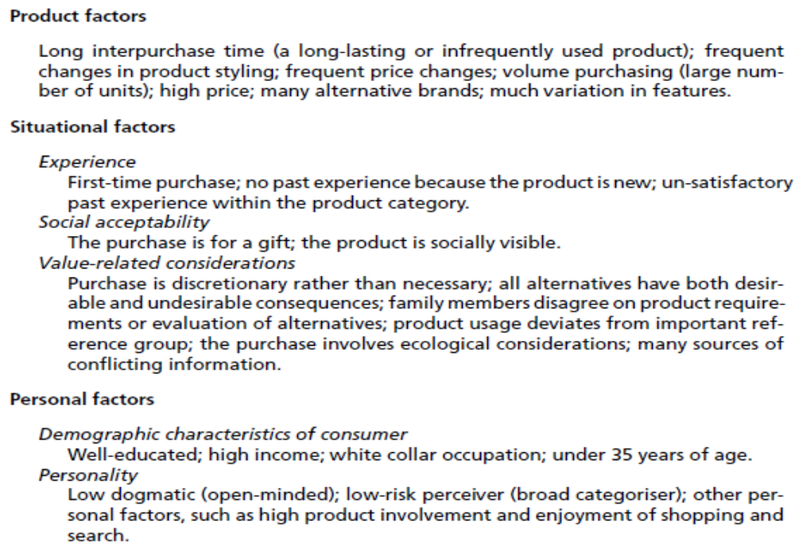
2- Factors affecting Information search

Slide 9
3- Evaluation of alternatives
Consumers find it difficult to make overall comparisons of many alternative brands because each brand might be better in some ways but worse in others.
Instead, consumers simplify their evaluation in several ways. First, they seldom consider all possible brands; rather, they focus on their evoked set – a limited number they are familiar with that are likely to satisfy their needs.
Second, consumers evaluate each of the brands in the evoked set on a limited number of product dimensions or attributes.
Consumers also judge the relative importance of these attributes, or the minimum acceptable performance of each. The set of attributes used by a particular consumer and the relative importance of each represent the consumer’s choice criteria.

Slide 10
3- Evaluation of alternatives
Consumers use many dimensions or attributes when evaluating alternative products and services.
Different consumers may use different sets of attributes to evaluate brands within the same product category.

Slide 11
Selected Attributes Consumers Use to
Evaluate Alternative Products or Services
Category
Cost attributes
Performance attributes
Social attributes
Availability attributes
Specific attributes
Purchase price, operating costs, repair costs, cost of extras or options, cost of installation, trade-in allowance, likely resale value.
Durability, quality of materials, construction, dependability, functional performance (acceleration, nutrition, taste), efficiency, safety, styling.
Reputation of brand, status image, popularity with friends, popularity with family members (Do the kids like the taste of Oscar Mayer hot dogs?), style, fashion.
Carried by local stores, credit terms, quality of service available from local dealer, delivery time.
Notes:
4

Slide 12
4- Purchase
Choosing a source from which to buy the product involves essentially the same mental processes as does a product-purchase decision.
The source is usually a retail store but may also be a mail-order catalogue or a website.
Consumers obtain information about alternative sources from personal experience, advertising, comments of friends, and the like. Then they use this information to evaluate sources on such attributes as lines of merchandise carried, services rendered, price, convenience, personnel, and physical characteristics. Consumers usually select the source they perceive to be best on those attributes most important to them.

Slide 13
4- Post-purchase evaluation
Whether a particular consumer feels adequately rewarded following a purchase depends on two things:
(1) the person’s aspiration or expectation level – how well the product was expected to perform.
(2) the consumer’s evaluation of how well the product actually did perform

Slide 14
Consumer Decision Making
The decision process pursued by a given consumer can be classified into one of four categories depending on whether
(1) the consumer has a high or low level of product involvement, and
(2) he or she engages in an extensive search for information and evaluation of alternative brands or makes the decision routinely.

Slide 15
Consumer Decision Making
Extent of involvement
Extent of analysis
Extended (information search; consideration of brand alternatives)
Habit/routine (little or no information search; focus on one brand)
High
Complex decision making (cars, homes, vacations)
Brand loyalty (athletic shoes, cologne, deodorant)
Low
Limited decision making, including variety seeking and impulse purchasing (adult cereals and snack foods)
Inertia (frozen vegetables, paper towels)
Notes:
2

Slide 16
High Involvement purchases
High involvement purchases involve goods or services that are psychologically important to the buyer because they address social or ego needs and therefore carry social and psychological risks (e.g., the risk of looking foolish to one’s family or friends).
They may also involve a lot of money and therefore financial risk. Because a consumer’s level of involvement with a particular purchase depends on the needs to be satisfied and the resources available.

Slide 17
High Involvement purchases
The first type of high-involvement purchases may involve complex decision making in case of extended information search and evaluation of competing brands (such as cars, vacation).
The second type of high-involvement purchases is more habitual/routine involving little or no information search and focus on one brand ( such as perfume). Highly brand-loyal customers resist competitive efforts on account of their strong brand preference.

Slide 18
Low involvement Decision
Because low-involvement products are not very important to consumers, the search for information to evaluate alternative brands is likely to be minimal. As a result, decisions to buy these products often are made within the store, either impulsively on the basis of brand familiarity, or as a result of comparisons of the brands on the shelf. The consumers’ involvement and their risks associated with making poor decisions are low for such products.
Most purchase decisions are low in consumer involvement – the consumer thinks the product or service is insufficiently important to identify with it.
Therefore, consumers are less likely to stay with the same brand over time. They have little to lose by switching brands in a search for variety.

Slide 19
Inertia
There are two low-involvement buying decisions. When there are few differences between brands and little risk associated with making a poor choice, consumers either buy brands at random or buy the same brand repetitively to avoid making a choice.
If no problems are experienced during consumption, consumers may continue to buy the brand out of inertia, at least until a competitor offers an attractive price promotion.
Thus, Marketers must be careful not to confuse such repeat inertial purchasing with brand loyalty because it is relatively easy for competitors to entice such customers to switch brands by offering cents-off coupons, special promotions, or in-store displays.

Slide 20
Impulse Purchasing and Variety Seeking
The second low-involvement purchase process is impulse buying, when consumers impulsively decide to buy a different brand from their customary choice or some new variety of a product. The new brand is probably one they are familiar with through passive exposure to advertising or other information, however.
Their motivation for switching usually is not dissatisfaction but a desire for change and variety.

Slide 21
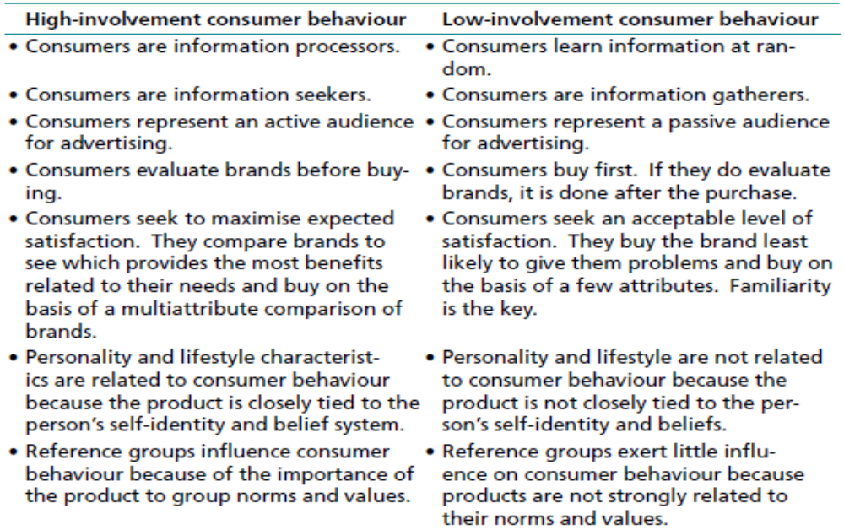

Slide 22
Strategies to Increase Consumer Involvement
The product might be linked to some involving issue (such as when makers of bran cereals associate their products with a high-fiber diet ).
The product can be tied to a personally involving situation (such as advertising a sleeping aid ).
Finally, an important new feature might be added to an unimportant product (ex; Revlon introduced its ColorStay Lipcolor)

Slide 23
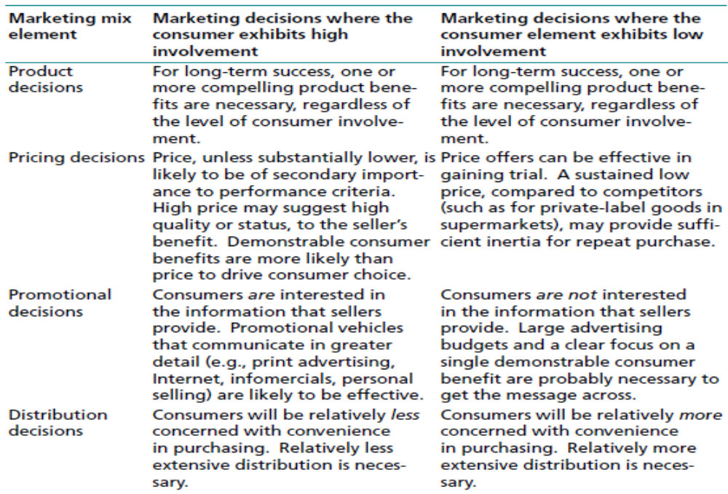
Inertia

Slide 24










Simplified Hierarchy of Social Forces
Affecting Consumer Behavior
Notes:
8
Use this slide to wrap up the previous discussion

